Slide 1
Quantifying the benefits of short-term reservations in on-demand ridepooling
Nander Theodoridis, TU Delft
Andres Fielbaum, University of Sydney
Javier Alonso-Mora, TU Delft
Bilge Atasoy, TU Delft

Slide 2
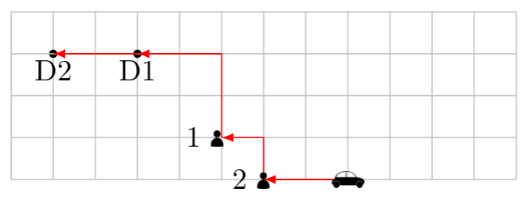
Motivation
On-demand mobility has been the major gamechanger in the last decade.
So far, it has increased vehicles-kilometres-travelled. This might change if On-Demand RidePooling (ODRP) is chosen instead.
ODRP has struggled to become massive. Can we make it more efficient?
This paper: Including short-term reservations can make the system more efficient, even if the extra info is compensated prioritising reserves.

Slide 3
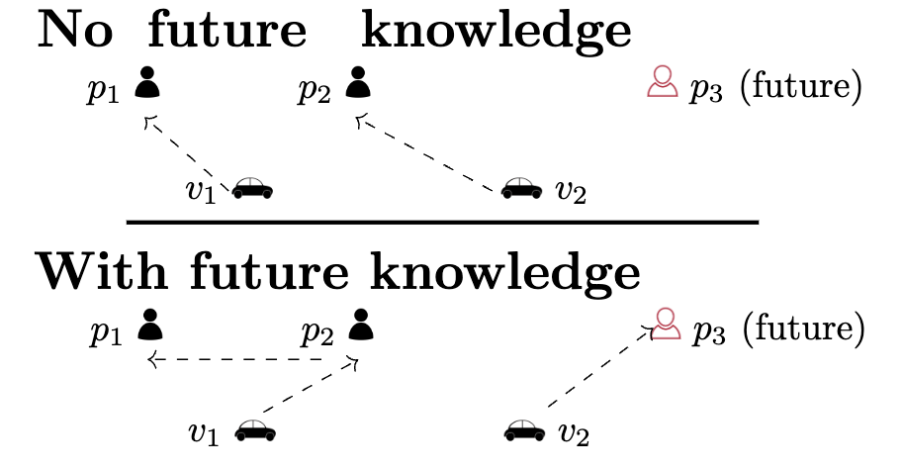
ODRP: Relevance of future information
Operating ODRP implies deciding how to group the users that travel together, how to assign them to vehicles, and how to route the vehicles. This is often done myopically:
Previous approaches: Change any of the decisions above according to the expected future demand.
Can we have actual future demand? E.g., have some of the users requesting their trips 10 minutes in advance?

Slide 4
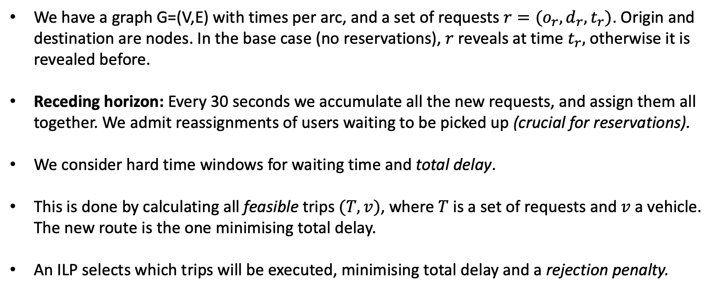
Method: Overview
We have a graph G=(V,E) with times per arc, and a set of requests $r=(o_{r},d_{r},t_{r})$. Origin and destination are nodes. In the base case (no reservations), $r$ reveals at time $t_{r},$otherwise it is revealed before.
Receding horizon: Every 30 seconds we accumulate all the new requests, and assign them all together. We admit reassignments of users waiting to be picked up (crucial for reservations).
We consider hard time windows for waiting time and total delay.
This is done by calculating all feasible trips $(T,v)$, where $T$is a set of requests and $v$ a vehicle. The new route is the one minimising total delay.
An ILP selects which trips will be executed, minimising total delay and a rejection penalty.

Slide 5
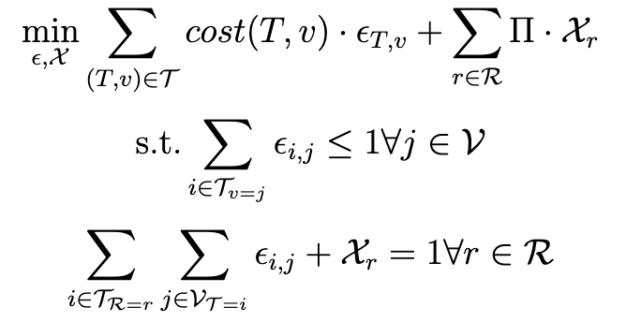
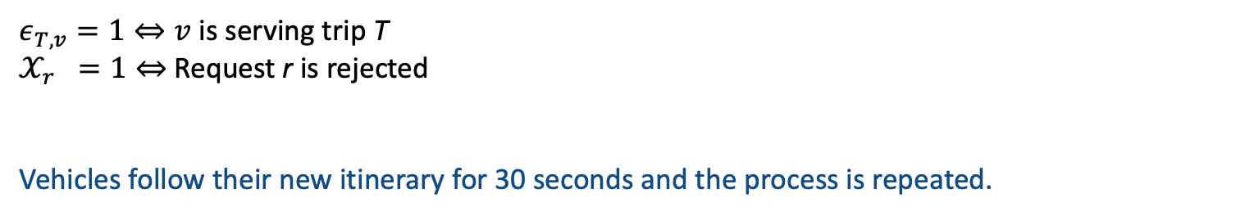
The ILP
$ε_{T,v}=1⇔v$ is serving trip T
$𝒳_{r} =1⇔$ Request r is rejected
Vehicles follow their new itinerary for 30 seconds and the process is repeated.

Slide 6
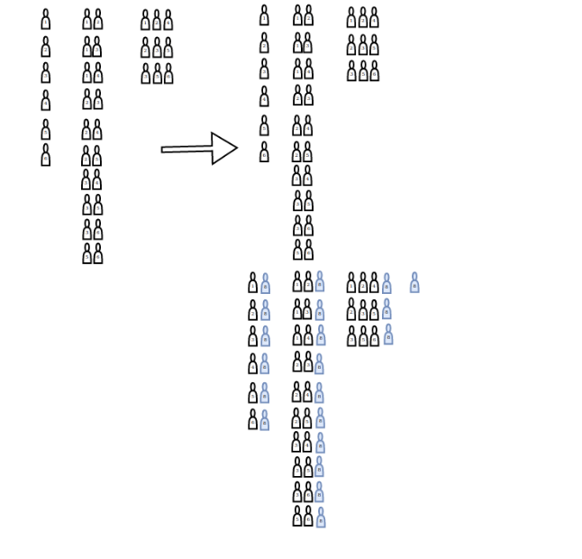
Method: Including reserves
In principle, including reserves is easy. They are just revealed x minutes before the desired trip, and stay in the queue till picked up.
Two relevant facts to consider:
1) Extra complexity: Reserves are easy to combine, stay in the
queue for a long time, and create long routes to evaluate.
2) Benefits: We want to consider benefits for the ones that reserve.
We try 2 methods:
i) Increase the rejection penalty.
ii) Pledged service constraint: If a reservation is originally
accepted, it stays as such.
Trade-off: More info but More constraints

Slide 7
Results: The New York scenario
We use the real-life dataset from Manhattan, New York. Approx 4k nodes, 10k edges, 10k requests during one hour of simulations (12-1 pm). 30 minutes of warm-up.
1000 vehicles of capacity four.
Many scenarios considering i) Different percentage of users reserving, and ii) How long in advance they reserve.
We consider random and adversarial reservations. The latter are the rejections in a scenario with no reservations.

Slide 8
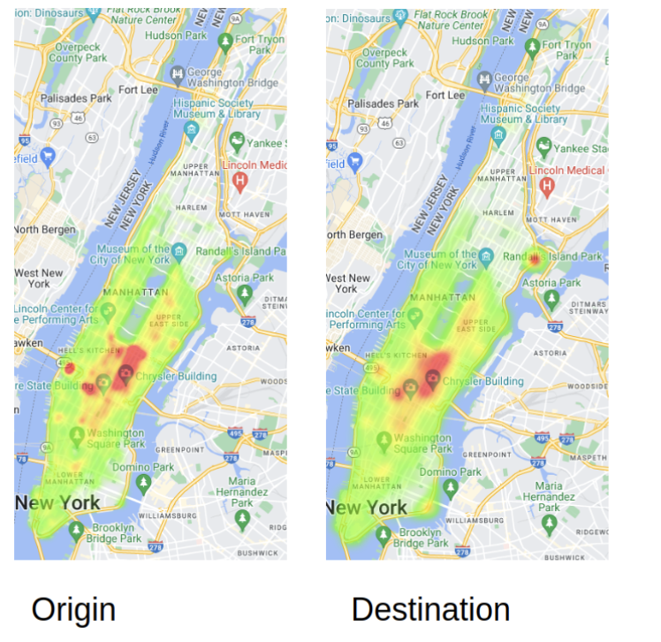
Results: Heatmaps

Slide 9
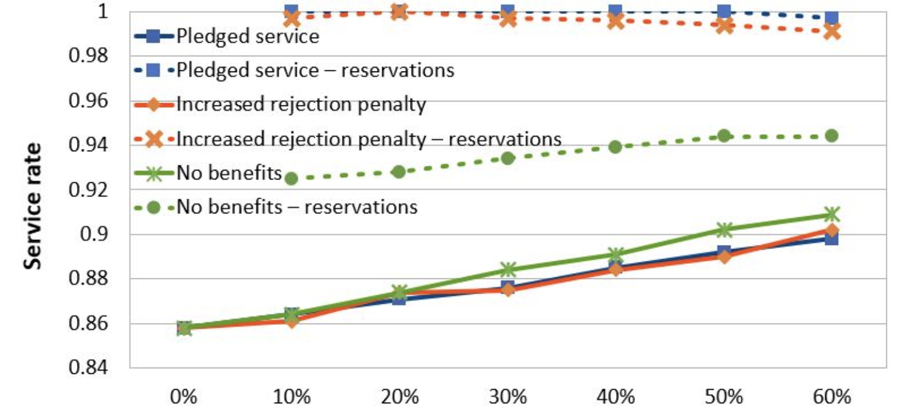
Results: Quantifying the trade-off
The three solid curves increase: reservations improve the service rate.
Benefits soften the improvement (orange and blue curves are below the green). The overall effect is always positive.
The benefits make a relevant difference for reservations.
Pledged service constraint is better than increased rejection penalty.
Reservations made 5 minutes in advance

Slide 10
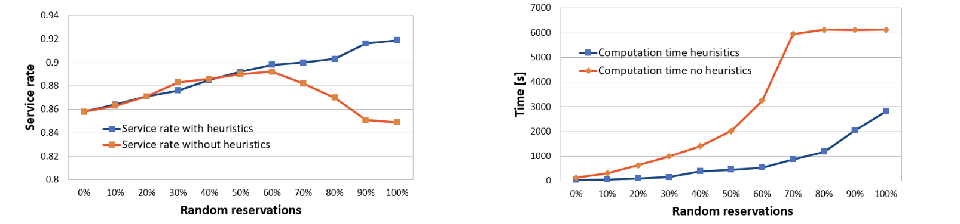
Results: Heuristics
We consider two heuristics: Not assigning more than 3 users per vehicle per iteration, and considering just the best 20 vehicles per user.
Both reduce (exponentially) the number of feasible groups.
With the heuristics, we don’t lose much and can handle up to 100% of reservations (5 minutes in advance).

Slide 11
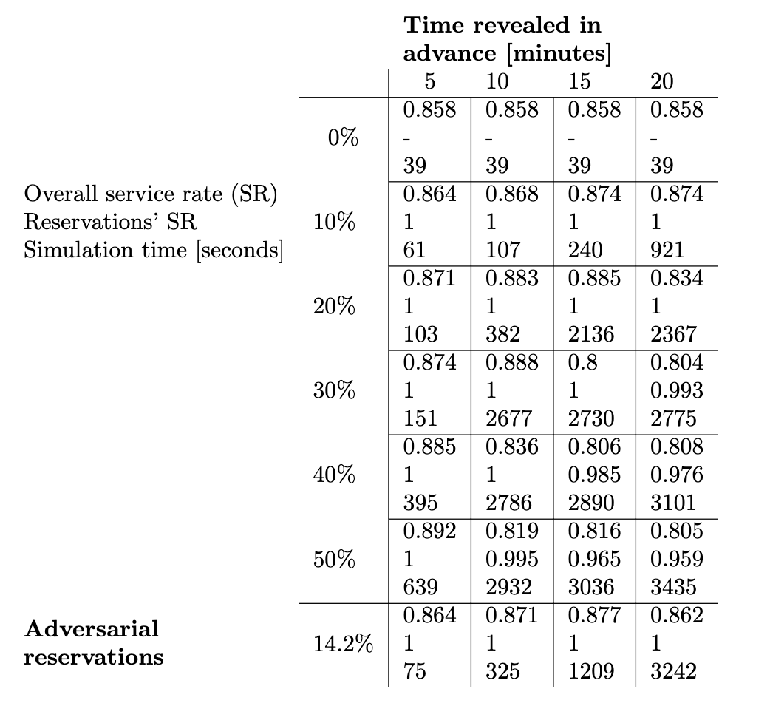
Results: How long in advance?
If there are too many reserves and too much in advance, they can be harmful. E.g. 20 minutes with more than 20% reserves.
This could be faced tightening the heuristics, but up to a point.
Reserves help even if they are adversarial and have benefits.
Sensitivity analysis using morning peak requests shows that our results are robust.

Slide 12
Summary and conclusions
We study the inclusion of short-time reserves in on-demand ridepooling. We identify a trade-off: More information to make better decisions, but need to offer benefits to users reserving.
We propose a method to include them. Two heuristics to deal with the increased complexity.
Results in Manhattan reveal that reservations improve the service rate even if they are adversarial and receive an immediate binding response.
Relevant managerial implications to improve the efficiency: Enable short-term reserves!
Further research: Improved heuristics to deal with many reserves, mixing with long-term reserves. Can we use this information to give more accurate predictions to waiting users?

